Slide 1
Control
Green Belt Training

Slide 2
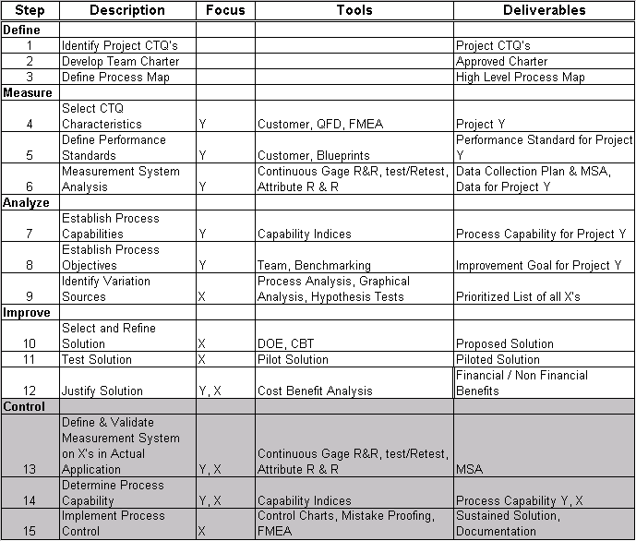
The 15-Step Process

Slide 3
Control Phase Overview
What is the Control phase?
The Control phase is when your team:
Ensures that the new process conditions are documented and monitored via statistical process control methods.
After a “settling–in” period, reassesses the process capability.
Closes the project

Slide 4
Control Phase Overview
Why is the Control phase important?
This phase is important because it ensures that process improvements are implemented together with appropriate process controls to ensure that the process changes are sustained into the future.
It also is an opportunity for the team to “prove” that the project process performance goal has been met.

Slide 5
Control Phase Overview
Steps involved in the Control phase
Control 13: Validate Measurement System (for Xs)
Control 14: Determine Process Capability
Control 15: Implement Process Control System & Project Closure

Slide 6
Control 13–Validate Measurement System
What does it mean to Validate Measurement System?
In the Measure phase, you focused on validating the measurement system for the Project Y. In this step, you should now validate the measurement system for the Vital X’s.
A Measurement System Analysis (MSA) is the overall process to test your data for its validity.
Before actually performing the MSA, you will have to develop a data collection plan for the Vital X’s.
You should focus on the Vital X’s at this point because you want to develop Control Plans for each Vital X.

Slide 7
Control 13–Validate Measurement System
Why is it important to Validate Measurement System?
Validating the Measurement System is important because you need to have data that you can trust in order to make decisions with that data.
If your data is not telling you the truth, you are likely to make a decision with that data that will add more variation to the process.
As part of your Process Control System, you will monitor the Vital X’s to make sure they stay in control. Therefore, you must validate the Measurement system used to collect the Vital X data.

Slide 8
Control 13–Validate Measurement System
What are the project tasks for completing Control 10?
Validate Measurement System
Determine whether Measurement System is adequate to measure Vital Few X’s

Slide 9
Control 14–Determine Process Capability
What does it mean to Determine Process Capability?
Process Capability is the measure of process performance relative to the Customer’s CTQ.
It is measured again at this point in the process in order to see if there was a process improvement.
If a pilot is conducted, the improvement team should measure process capability from the pilot and then, once full implementation takes place, measure process capability again.

Slide 10
Control 14–Determine Process Capability
Why is it important to Determine Process Capability?
Process Capability is important at this stage of the project because you want to be able to compare baseline performance before improvements to the new Process Capability once improvements have been implemented.
It is also important to statistically validate the improvement in the process through the use of a Hypothesis Test, such as the 2-Sample t-test for Continuous data and Chi Square for Discrete data.

Slide 11
Control 14–Determine Process Capability
What are the project tasks for completing Control 14?
Evaluate Process Capability of the improved process
Confirm statistically that the improvement goal has been met

Slide 12
Control 15–Implement Process Control Systems
What does it mean to Implement Process Control System?
A Process Control System is a system of activities whose purpose is to maintain process performance at a level that satisfies customers’ needs and drives the ongoing improvement of process performance.
A Process Control System consists of three parts: Documentation, a Monitoring Plan and a Response Plan.
During this step of the project, you are also ready for project implementation. Once the improvement is implemented and the process improvement is verified, the final step of the project is Project Closure.
During Project Closure, you will finalize project documentation, leverage learning to other areas of the business and celebrate project completion with your team.

Slide 13
Control 15–Implement Process Control Systems
Why is it important to Implement Process Control?
A Process Control System will help maintain the gain that occurred with the process improvement.
Without control of an improved process, the process tends to revert to its old performance.

Slide 14
Control 15–Implement Process Control Systems
What are the project tasks for completing Control 15?
Implement a Control strategy for each Vital X
Prepare Process Control plan
Implement a solution
Close the project

Slide 15
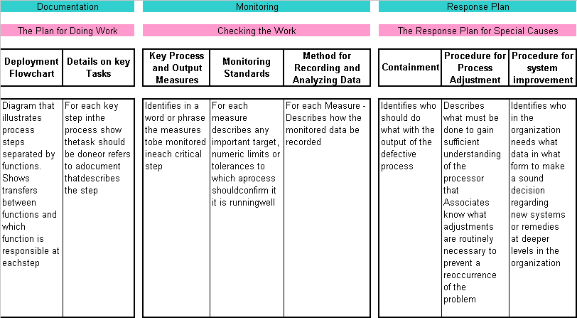
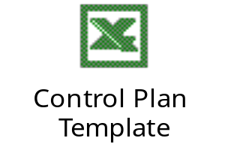
Process Control Plan Worksheet

Slide 16
Develop Control Mechanism
Correction Loop
Robust
Process
Preventive Measure
Targeted Settings
for
Vital X’s
Early Detection & Control
Targeted
Sigma / DPMO
Damage Control
Customer CTQ
Too Late in the Day

Slide 17
Correction Loop
Prevention
Prevention
Detection
Mistake-Proofing
Statistical Process
Control on X
Statistical Process
Control on Y

Slide 18
Mistake Proofing (Poka-Yoke)
Introduction
Mistake proofing is a quality assurance technique which aims to eliminate defects in a product or service by preventing or correcting mistakes as early as possible.
Background
Japanese manufacturing engineer Shigeo Shingo in the 1960s developed mistake proofing. It is also called Poka-yoke (POH-kah YOH-kay) and comes from the Japanese words “Poka” (inadvertent mistake) and “yoke” (prevent).

Slide 19
Mistake Proofing - Steps
Identify
Problems
Brainstorming
Customer complaints
Error reports
Rejection analysis
1
Prioritize
Problems
FMEA
Cost & Effort estimate
COPQ
2
Identify
Root-cause
Don’t cover-up
Don’t treat symptoms
Correct errors at source
3
Find
Solutions
Make it impossible to go wrong
Be creative – think out of the box
4
Measure
Outcome
Have errors been eliminated?
What is the financial impact?
5

Slide 20
Mistake Proofing - Techniques
Technique
Prevention
Detection
SHUTDOWN
A mistake is about
to be made
A mistake has been
made
CONTROL
Defects are impossible
Defective parts can’t
move to next process
step
WARNING
Something is about
to go wrong
Something has just gone
wrong

Slide 21
Mistake Proofing - Examples
Technique
Prevention
Detection
SHUTDOWN
Cameras that don’t click
if the shutter is on
Air-conditioners trip when
detect slight over-heating
CONTROL
ATM does not accept a
card inserted wrongly
Quality check at each
point in the assembly
WARNING
Car security system
alerting the driver that all
doors are not closed
Smoke detectors

Slide 22
Class Exercise
Each team takes any three of the situations & apply mistake-proofing techniques
Car owners complain that they often forget if the fuel tank hole is on the left or right side of the car.
A cold drink manufacturer wants to ensure that all bottles are filled with exactly the same quantity.
Commuters complain that ‘free left’ is always blocked by the vehicles that have to go straight.
HR team of a company has found that employees only punch-in & don’t punch-out.
Bank customers complain that they find it difficult to keep track of checks issued by them.
Administration team of a company finds that employees don’t switch-off lights while leaving.
A FMCG company has found that retailers don’t disburse the freebies to customers as due.
Credit card customers complain that they end up over-spending on their cards.
Subscribers to a cellular service company want to ensure they keep track of their missed calls even after erasing from memory.

Slide 23
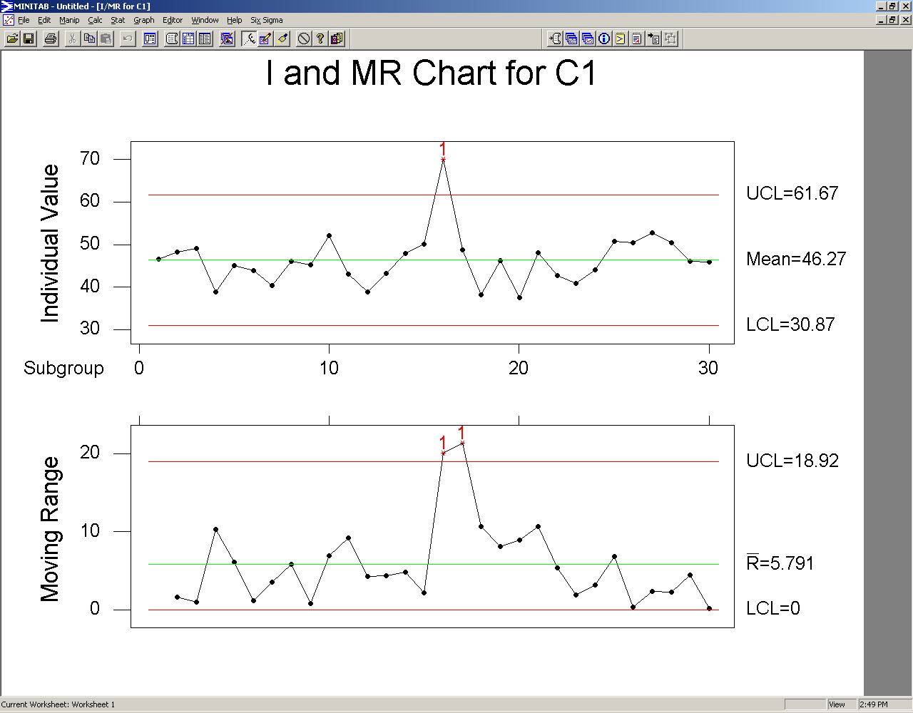
Statistical Process Control – Overview
SPC was developed by Walter A. Shewhart in 1924
Historically, SPC has been used to monitor & control output ‘Y’
In DMAIC, we apply SPC to control X’s (remember ‘Y’ is only monitored)
However, sometimes applying SPC to ‘Y’ can also be beneficial in detecting trends

Slide 24
Variation And Control Charts
Control charts are used to distinguish between common and special causes of variation and use that understanding to control and improve processes.
Control charts are characterized by two things:
The average (mean), or centerline, which represents the middle point about which plotted measures are expected to vary randomly.
Control limits, both upper and lower, which represent the performance boundaries you can expect for the process. Although measures vary, one would not expect to see plotted measures outside of these boundaries if the process operated predictably.
*Note: Minitab displays control limits as ± 3 standard deviations

Slide 25
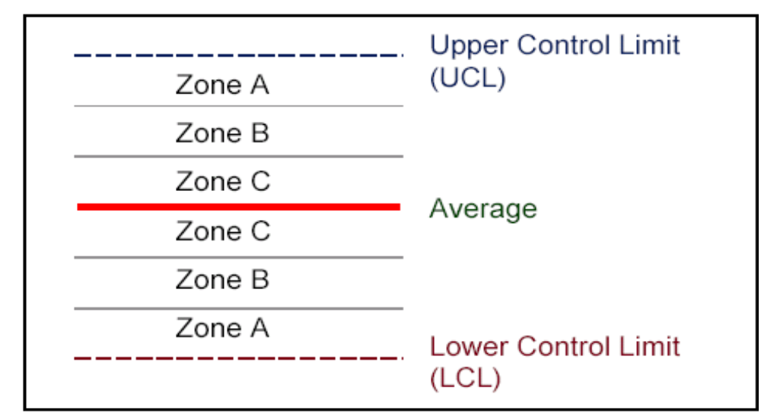
Determining If Your Process Is “Out Of Control”
Dividing the control chart into zones can aid in detecting special cause variation. Each of the zones represent standard deviations from the mean. Zone C, for example, is + and – 1 standard deviation from the average.

Slide 26
Control Chart Rules
One point beyond zone A
Nine points in a row in zone C or beyond (All on one side.)
Six points in a row, all increasing or decreasing
Fourteen points in a row, alternating up and down
Two out of three points in a row in zone A or beyond
Four out of five points in a row in zone B or beyond
Fifteen points in a row in zone C, above or below center
Eight points in a row beyond zone C, above or below center

Slide 27
Control Limits vs. Specification Limits
Control Limits | Customer Specification Limits
Defined based on process performance (+/- 3 estimated standard deviations from the mean) | Defined based on feedback from the customer(s)
Help determine if your process is “in control” (without special cause variation) | Help determine if your process is producing defects
Plotted on control charts | Plotted on histograms (not control charts)
Change when there is a verified, significant change to your process | Change when your customers say they do!
Represent the voice of the process | Represent the voice of the customer

Slide 28
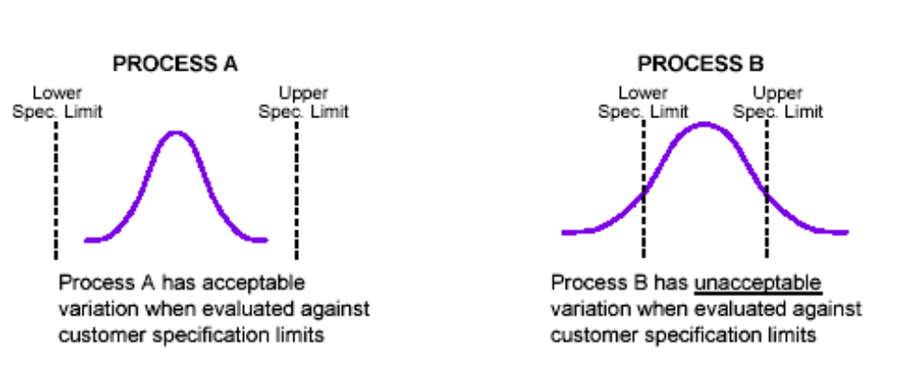
Control Limits vs. Specification Limits (continued)
It is possible to have a stable (in control) process that has unacceptable variation
Assume both process A and B are statistically performing “in control”
When a process is in statistical control and has unacceptable variation, work on the reduction of variation due to common causes.
To reduce common cause variation, make improvements to the Vital Few X variables

Slide 29
Types of Errors in Control Charts
How you treat the variation
Common Causes
Special Causes
Focus on fundamental process change
Mistake 1
Tampering
(Increases variation)
Common Causes
What the variation really is
Mistake 2
Under reacting
(missed prevention
Focus on investigating special causes
Special Causes

Slide 30
Types of Errors in Control Charts
3σ-level Control Limits
– Created by Dr. Walter Shewhart to minimize two types of mistakes
– Placed empirically because they minimize the two types of mistakes
– Are not probability limits
Two types of Mistakes:
– Calling a special cause of variation a common cause of variation (Missing a chance to identify a change in the process)
– Calling a common cause of variation a special cause of variation (Interfering with a stable process, wasting resources looking for special causes of variation that do not exist)
Control limits vs. Specification limits
– Control limits are determined by process data
– Specification limits are determined by customer needs

Slide 31
Two Types of Control Charts
Variable Charts
Uses Measured Values
Cycle Time, Lengths, Diameters, etc.
Generally One Characteristic Per Chart
More Expensive, But More Information
Attribute Charts
Pass/Fail, Good/Bad, Go/No-Go Information
Can Be Many Characteristics Per Chart
Less Expensive, But Less Information

Slide 32
Implement Process Control
Selecting a Control Chart
Data Types
Variable Data
Discrete Data
Sub-grouping not Possible
Sub grouping Possible
Yes / No Data (Defectives)
Count Data (Defects)
Individual & Moving Range (I MR) Chart
X Bar R Chart
Sample Size Constant
Sample Size Variable
Sample Size Constant
Sample Size Variable
c Chart
u Chart
np Chart
p Chart

Slide 33
Selecting the Appropriate Control Chart
There are many different types of control charts. The primary determinant of which type of control chart to use is the type of data being analyzed.
If the data being analyzed is continuous (variable), you would use either:
The “Individuals & Moving Range” (I-MR): use if Rational Sub-grouping is not possible (you want to see each transaction on the control chart)
The X Bar and Range (X Bar R): Use if Rational Sub-grouping is possible. Typically sub group size will be between 3 and 5. Use X Bar S if sub group size is greater than 7
If the data being analyzed is discrete (attribute), you would need to determine:
If you have a constant lot (sample) size (c / np)or if the lot (sample) size is not constant (u / p).
If you are counting defects, you may have multiple defects per unit. If you are counting defectives, the unit either is or is not defective.

Slide 34
Activity: Selecting Control Charts: 10 minutes
A team from Marketing is tracking response rates (yes, no) on telemarketing calls. Each day, they randomly sample 100 responses from their outgoing calls. The number of positive responses is plotted on the chart.
The technical support area is monitoring average response time on help requests. Each hour, 5 calls are sampled.
A team is monitoring the number of applications received each day with incomplete fields. All applications are being audited. Each day, 200-250 applications are received.
A team is monitoring the cycle time for the underwriters’ loan decisions. The data comes in slowly; that is, one loan is completed daily.
A team is tracking the number of fields left blank on an application. Each day, a sample of 100 applications is audited.
Another team is doing the same thing as the team in example 5 (counting the number of fields left blank on an application), only they are looking at all the applications that come in daily. Each day, 50-100 applications are turned in.
The team is tracking the number of abandoned calls to a customer call center in a shift. Each shift takes from 200-400 calls.

Slide 35
Variable Control Charts–X bar R Chart
A Valid Variable Control Chart Has…
Data in time or production sequence
  To show stability, time-to-time variation
A measure of central tendency
  To portray behavior of process center
A measure of variability
Control limits
  To allow separating common cause from assignable (special) cause
X bar Chart: a plot of the sample means over time
R-Chart: a plot of the range (difference between highest and lowest values) of a sample over time

Slide 36
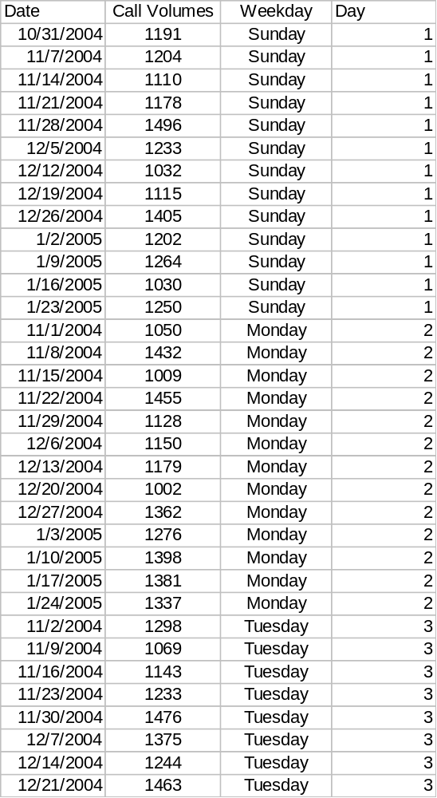
X bar R Chart
You are trying to evaluate efficacy of controls around number of calls answered in the center on each given weekday.
You collect data for 3 months and evaluate it using X bar R
This is what your data looks like.
Assign numeric codes to weekdays and arrange in an order (either ascending or descending)

Slide 37
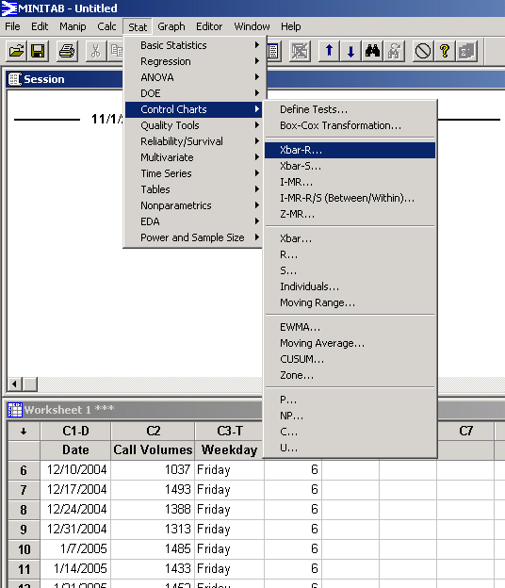
X bar R Chart
Paste this data into Minitab
Go to Stat > Control Charts> X Bar R

Slide 38
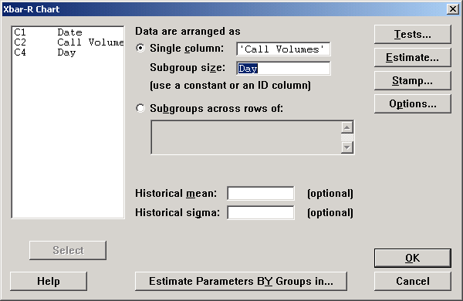
X bar R Chart
In ‘Single Column’ select ‘Call Volumes’ and for ‘Subgroup size’ select ‘Day’ (numeric codes) and click OK

Slide 39
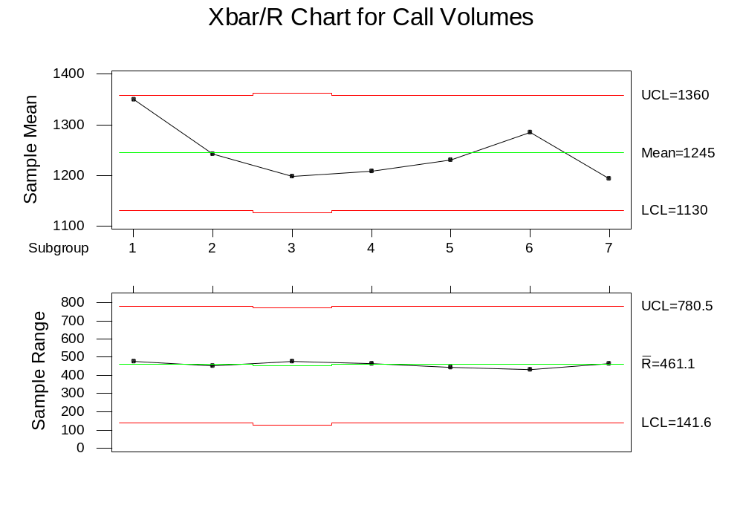
X bar R Chart
Sunday: 1
Monday: 2
Tuesday: 3
Wednesday: 4
Thursday: 5
Friday: 6
Saturday: 7
What can you analyze from this chart?

Slide 40
Variable Control Charts–I & MR Chart
Similar to X bar & R-Charts, except...
Single Values, Not Subgroups
Range Values must be artificially constructed
Somewhat “Noisier”, since you track each individual value (transaction,etc.)
Individuals Chart: a plot of the individual values over time
Moving Range Chart: a plot of the moving range over time

Slide 41
I & MR Chart
Individual Data Moving Range
10 NA
15 (10-15)=5 (Absolute values)
12 (15-12)=3
16 (16-12)=4
Individuals
An Individuals chart plots actual data–each transaction.
A Moving Range chart calculates ranges between consecutive data points (absolute value). You lose one data point, since the range is not calculated for the first point.
Moving Range

Slide 42
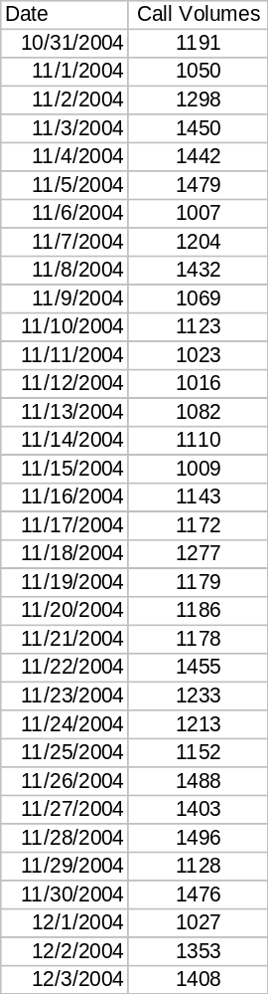
I & MR Chart
Continuing with the same example we took for the X Bar R chart, if we do not want to analyze call volumes for particular weekdays, we will use I and MR charts
Paste your data in date order in to Minitab

Slide 43
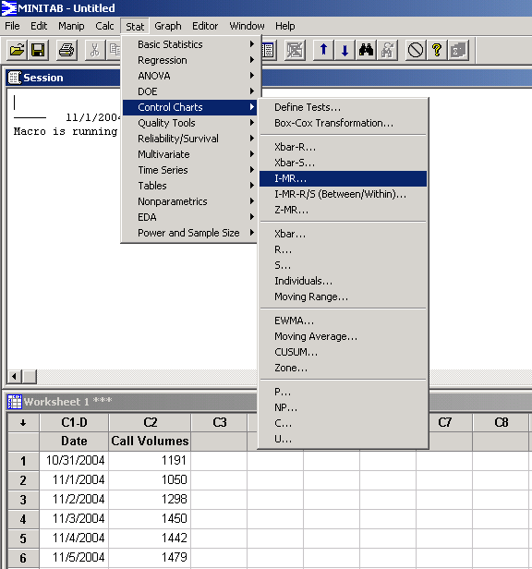
I & MR Chart
Click on Stat > Control Charts > I-MR

Slide 44
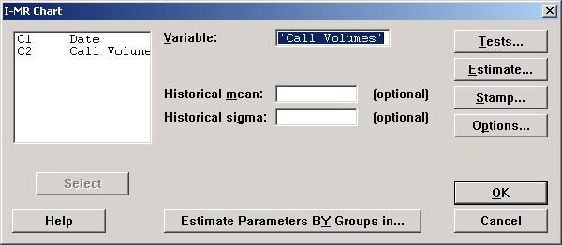
I & MR Chart
In the ‘Variable’ column, select ‘Call Volumes’ and click on OK

Slide 45
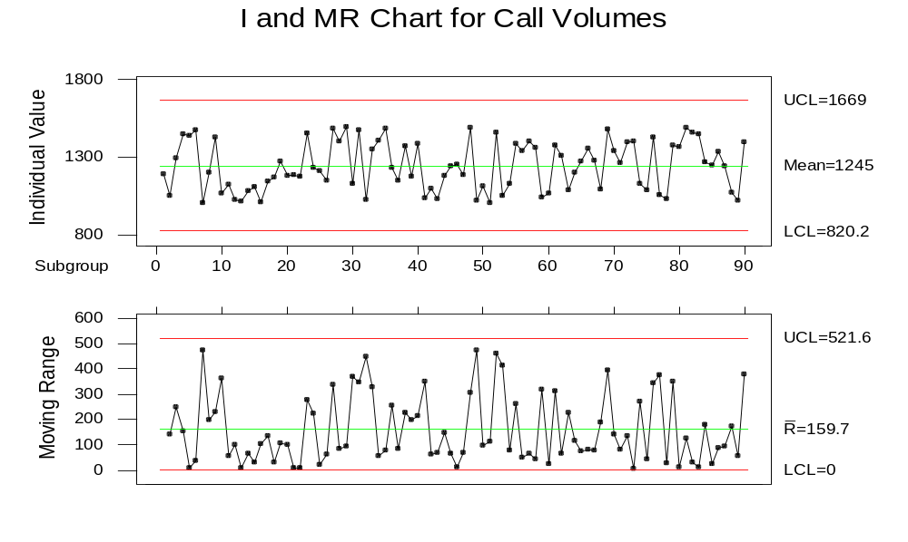
I & MR Chart
What can you interpret from this control chart?

Slide 46
Take Aways–Variable Control Charts
Variable control charts can be used with continuous data to tell when a process is:
  Experiencing only common cause variation and working at its intended best
  When the process is disturbed and needs corrective action
Control charts:
  Time ordered plot of data
  Reflect the expected range of variation of the data
  Identify when a special cause appears to be influencing the data
X bar & R-Charts are used for plotting means and ranges of subgroups over time
I & MR charts are used for plotting individual values and moving ranges over time

Slide 47
Take Aways–Variable Control Charts
Control limits are typically calculated as + 3 standard deviations away from the mean of the process
Control limits and specification limits are not the same
  Control limits are calculated from the sample data; they are internal to the process
  Specification limits are determined by your performance standard; they are external to the process (generally come from the customer)
Know when a process is out of control
Control charts are only as good as the actions that you take to keep the process in control

Slide 48
Attribute Control Charts
Constant Sample Size
Variable Sample Size
C
U
Defects
NP
P
Defectives
To choose the appropriate attribute control chart, use the following factors:
Is it defects or defectives that you are investigating in the data you are collecting?
  For example:
  Is it pass/fail for the part or process?
  Or is it several sub-components or sub-processes passed/failed for the part or process?
Is it a constant lot (sample) size or variable lot (sample) size?

Slide 49
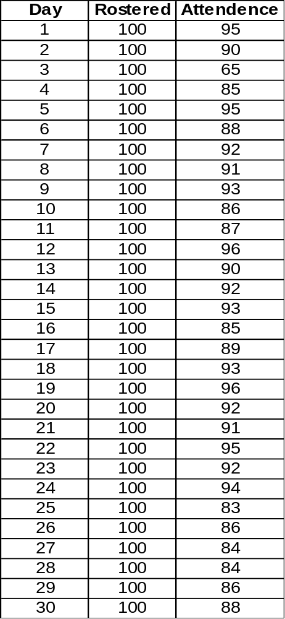
Attribute Control Charts : NP charts
Each day for a month 100 CCS are rostered to take up calls for a particular LOB.
Following is the day wise attendance data for numbers of CCS actually turning up.
Paste the data into Minitab as shown

Slide 50
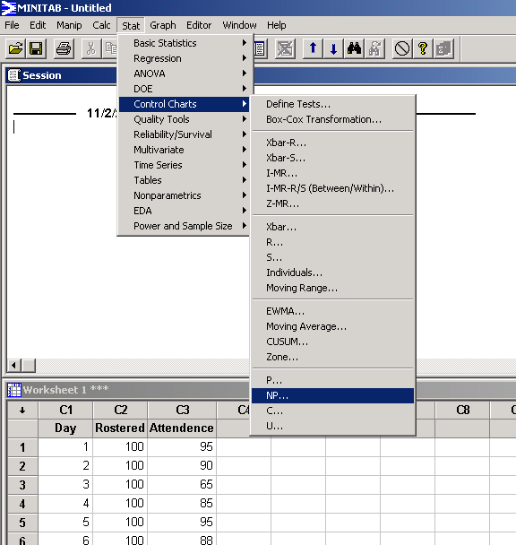
NP charts
Click on Stat > Control Charts > NP…

Slide 51
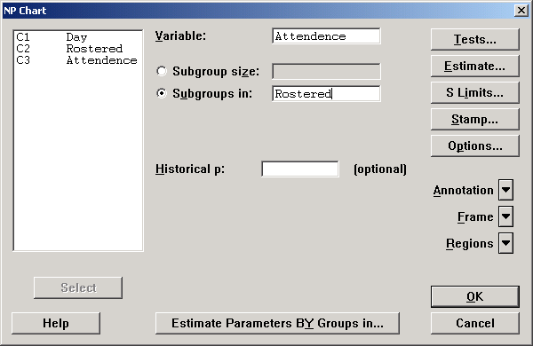
NP charts
For ‘Variable’ select ‘Attendance’ (Defectives)
For ‘Subgroups in’ select ‘Rostered’
Click on OK

Slide 52
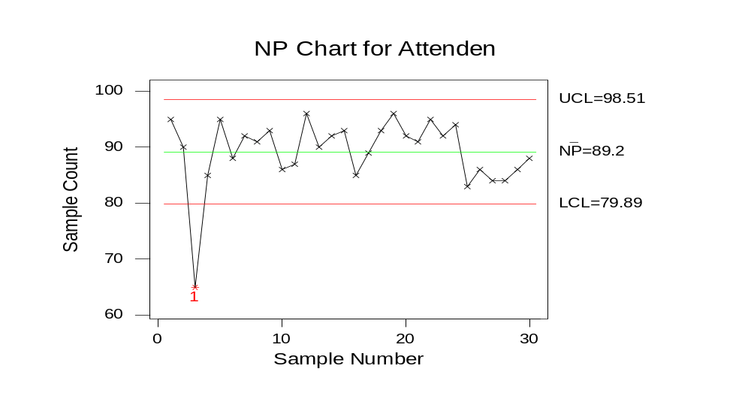
NP charts
What can you interpret from this chart?

Slide 53
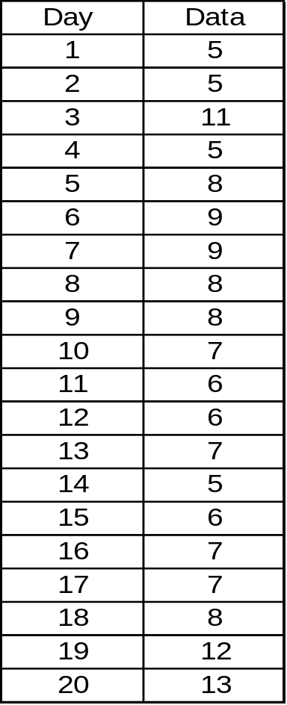
Attribute Control Charts : C charts
An applications group of a large insurer recently made some changes to the design of their application.
The old applications had 10 fields for the customer to fill out; the new application has 5 fields for the customer to fill out. They are now monitoring the incoming applications to ensure the new design has had an impact on completeness.
A random sample of 100 applications are reviewed each day and the total number of incomplete fields are plotted.

Slide 54
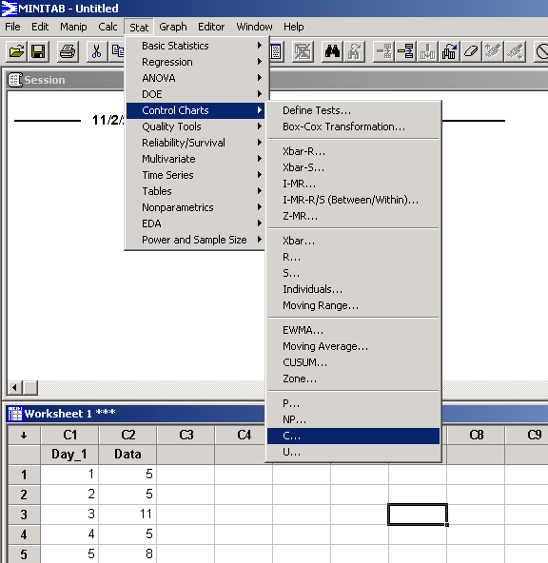
C charts
Click on Stat > Control Charts > C…

Slide 55
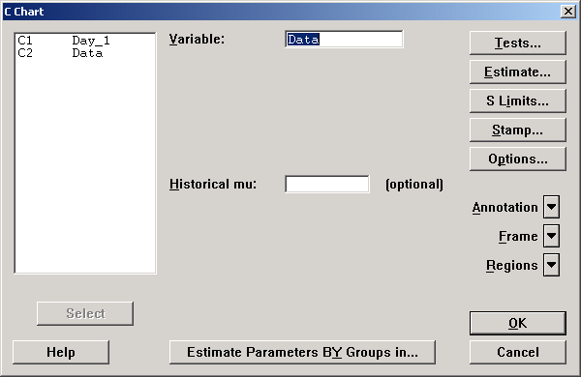
C charts
In ‘Variable’ select Data and click on OK.

Slide 56
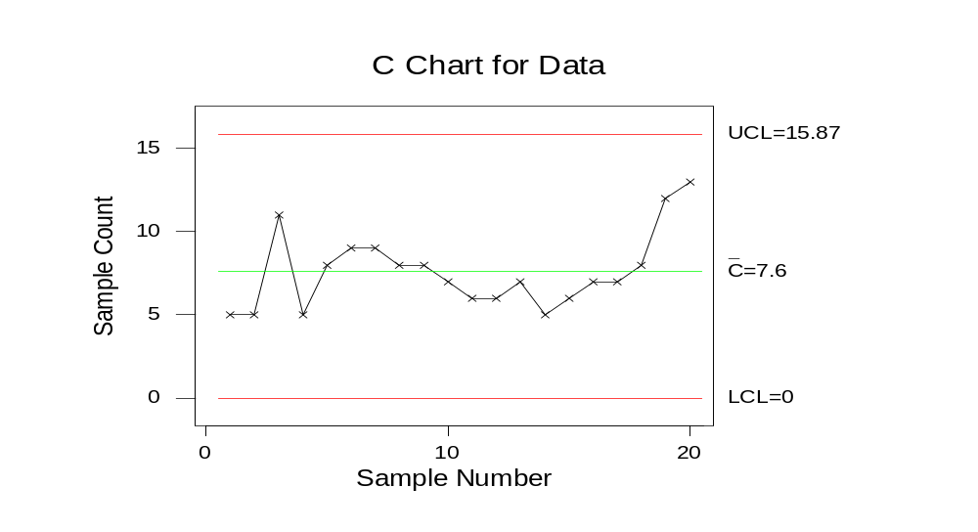
C charts
What can you interpret from this chart?

Slide 57
Summary of Attribute Charts
Useful when variable data not available
Use count/classification data–pass/fail, good/bad
Same general rules for interpretation as variable charts
Useful as end-to-end overview; use variable charts for further study of problems
Can use data gathered for other purposes
Generally less expensive to administer, but tell you less
Shortcomings
Including too many variables makes interpretation difficult
Need to evaluate whether constant/non-constant lot size will help you with root cause analysis
Sensitivity is dependent on magnitude of defect level

Slide 58
Take Aways Attribute Control Charts
Attribute control charts are used to monitor the level of nonconformance of a process
Select the appropriate attribute control chart based upon
  Constant vs. variable lot (sample) size
  Defects vs. defectives
Defect
  A single characteristic that does not meet requirements
Defective
  A unit that contains one or more DEFECTS

Slide 59
Summary–Control Charts
All control charts have the same form
  – Time plot of data
  – Statistical limits placed +/- 3s from center line
Choose the control chart according to:
  – Data type
  – Sample size
Interpret and act on the control chart
  – Investigate special causes of variation
  – Assess baseline sigma in order to understand if we are performing to customer CTQ’s
  – Shrink common cause variation by making changes in the Vital Few X variables
Maintain the control chart
  – Make notes on the control chart to indicate problems, changes, or important events

Slide 60
Misconceptions about Control Charts
Misconception 1
Control Charts will control the process
No
Control Charts will only show what is occurring in the process

Slide 61
Misconceptions about Control Charts
Misconception 2
A Process in Control is a “Capable Process”
No
Process Control and Process Capability are not the same

Slide 62
Problem Solving Flow
Business problem is discovering customer & business CTQ’s, establishing performance parameters & validating measurement systems
Statistical problem is determining the baseline, setting a target performance & identifying variation sources
Statistical solution is discovering vital X’s, their best settings & operating limits
Business solution is institutionalization of the results – control, audit & translation

Slide 63
How to Correct Project Break-downs
Reason for Break-down
Correction Mechanism
In-sufficient functional
X-Y relationship
Re-scope the project
Look for alternative Y’s
Uncontrollable ‘X’
Re-visit control plan
Explore sub-X’s
Target setting for ‘X’ has changed
due to other CTQ’s
A vital ‘X’ database is necessary
MBB & champions should prioritize
Some trivial X’s have become more
important in the process
Include new X’s in the model
Update control plan

Slide 64
How to Sustain Process Improvement
Control Plan
Training & Communication
Project handovers with completed project dockets
Database of vital X’s
QFD / VOC
FMEA / Fishbone
Six Sigma Project Audits
Process Owners
SOP’s

Slide 65
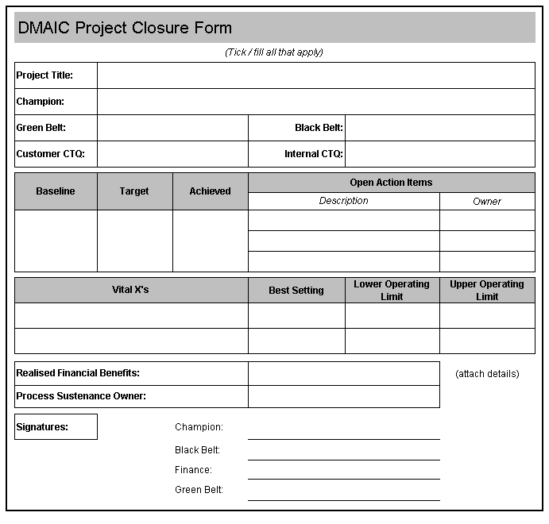
Toll Gate Sign Off

